Slide 1
DENGUE PREDICTION THROUGH CLIMATIC DATA
By:
M. Akhila(17251A0580)
B. Ruchira(17251A0584)
R. Sri Laxmi Ragini(17251A05B3)
Internal Guide
Mrs. K Sneha Reddy

Slide 2
CONTENTS
Introduction
Existing System
Proposed System
Objectives
System Architecture
Algorithms
Modules
Implementation
Results
Conclusions
Future scope

Slide 3
INTRODUCTION
Incidence of dengue infection has increased approximately 30 times since 1950.
Dengue is found in tropical and sub-tropical climates
Around 20,000 people die per year due to this.

Slide 4
EXISTING SYSTEM
Using previous predicted values
Previously predicted values are considered for the prediction. In some models some other climate factors also considered.
Disadvantage
It does not consider essential factors like temperature and other, thus compromising the model.
Using some climatic factors
Factors like sunlight, temperature, precipitation is taken to know the outbreak in the a region.
Disadvantage
These models are considering only partial factors.

Slide 5
PROPOSED SYSTEM
Based on climate data predict number of dengue cases using ML algorithms.
Help user in identification of dengue by examining symptoms
Provide statistics of people who are also experiencing symptoms within the area of user.

Slide 6
OBJECTIVES
To develop a model for early dengue forecast
To analyze symptoms of user to check for dengue.
To provide statistics to the user about dengue affected people in their region
To consider various climate factors and predict outbreak in the region

Slide 7
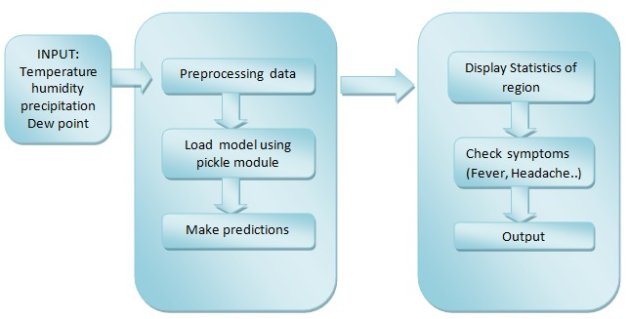
SYSTEM ARCHITECTURE / METHODOLOGY
.

Slide 8
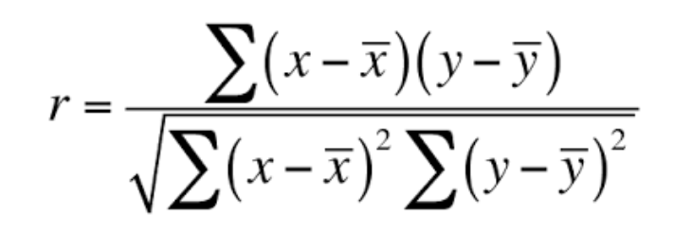
ALGORITHMS
Feature selection algorithms:
Pearson’s correlation (filter-based method)
Recursive Feature elimination (wrapper based method)
Algorithms used :
Linear Regression, kneighbours regressor, Support vector Regressor, Decision Tree for estimating the output

Slide 9
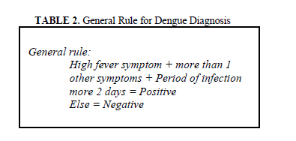
Dengue fever Symptoms
Temperature: Above 40
High fever, headaches, Pain behind the eyes, Severe joint and muscle pain, Nausea, Vomiting, Skin rash, No appetite
Severe dengue Symptoms
Temperature: Above 40 or Intermittent fever
Swollen glands, Severe abdominal pain, Bleeding gums, Vomiting blood, Rapid breathing , Fatigue/ restlessness

Slide 10
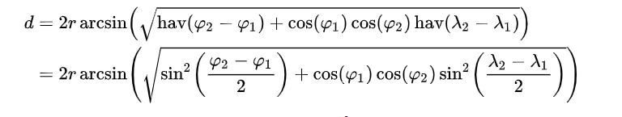
Displaying statistics
The haversine formula determines the great-circle distance between two points on a sphere given their longitudes and latitudes

Slide 11
IMPLEMENTATION
Open weather map Onecall API is used to collect weather data automatically by using latitude and longitude of user
API sends the hourly data in JSON format
Flask is used to build the entire web application

Slide 12
RESULTS
Algorithms performance:
Algorithm name | Mean absolute error | Root mean squared error | R2_Score
Linear Regression | 22.46 | 51.86 | 0.1
KNeighbours | 7.26 | 11.68 | -0.25
Support vector regression | 6.32 | 10.98 | -0.1
Decision Tree | 0.03 | 0.34 | 0.99

Slide 13
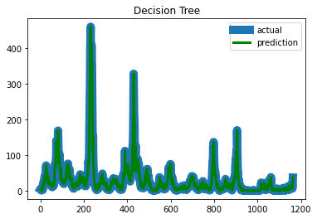
Decision tree Actual vs Predicted graph

Slide 14
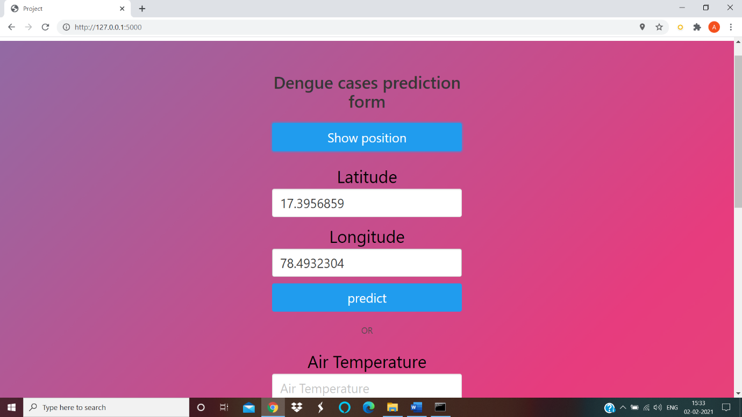

Slide 15
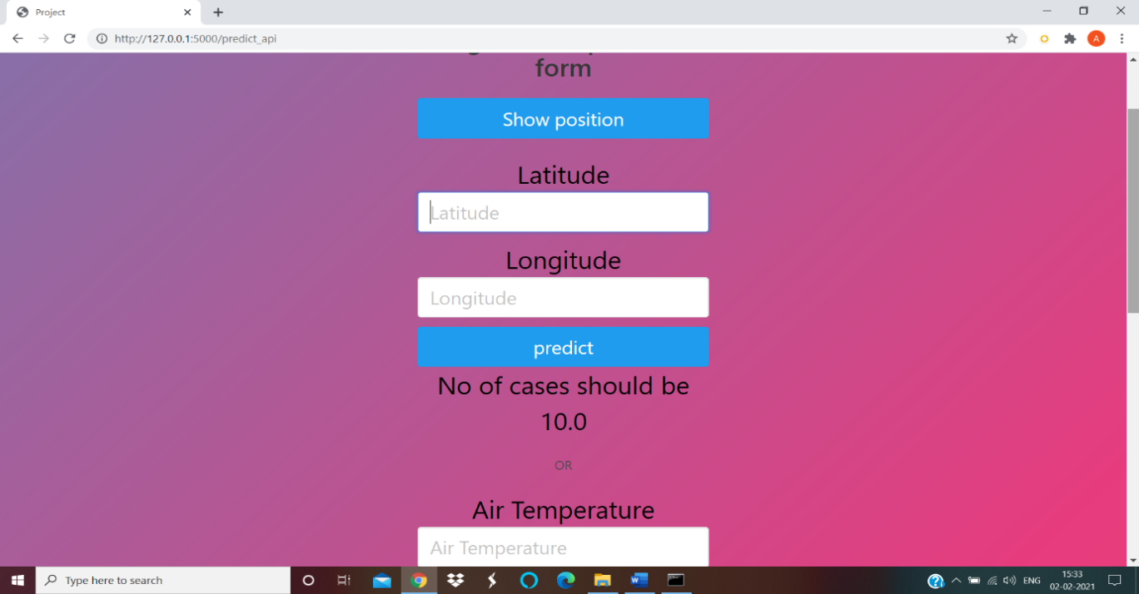

Slide 16
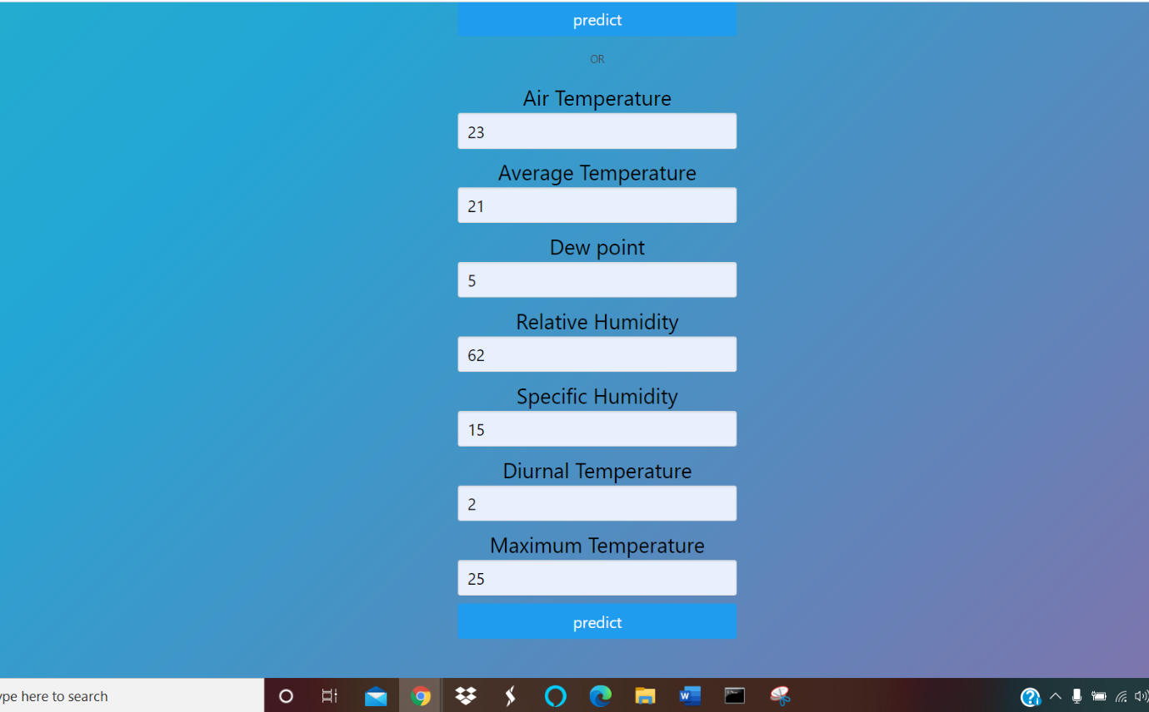

Slide 17
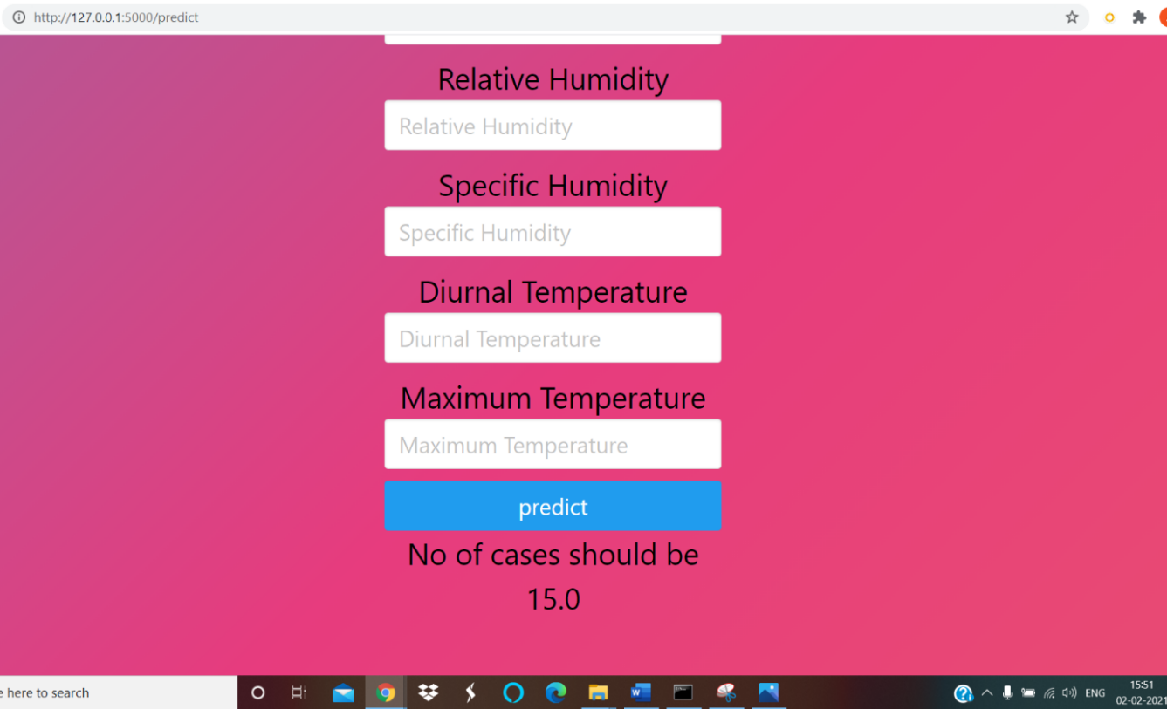

Slide 18
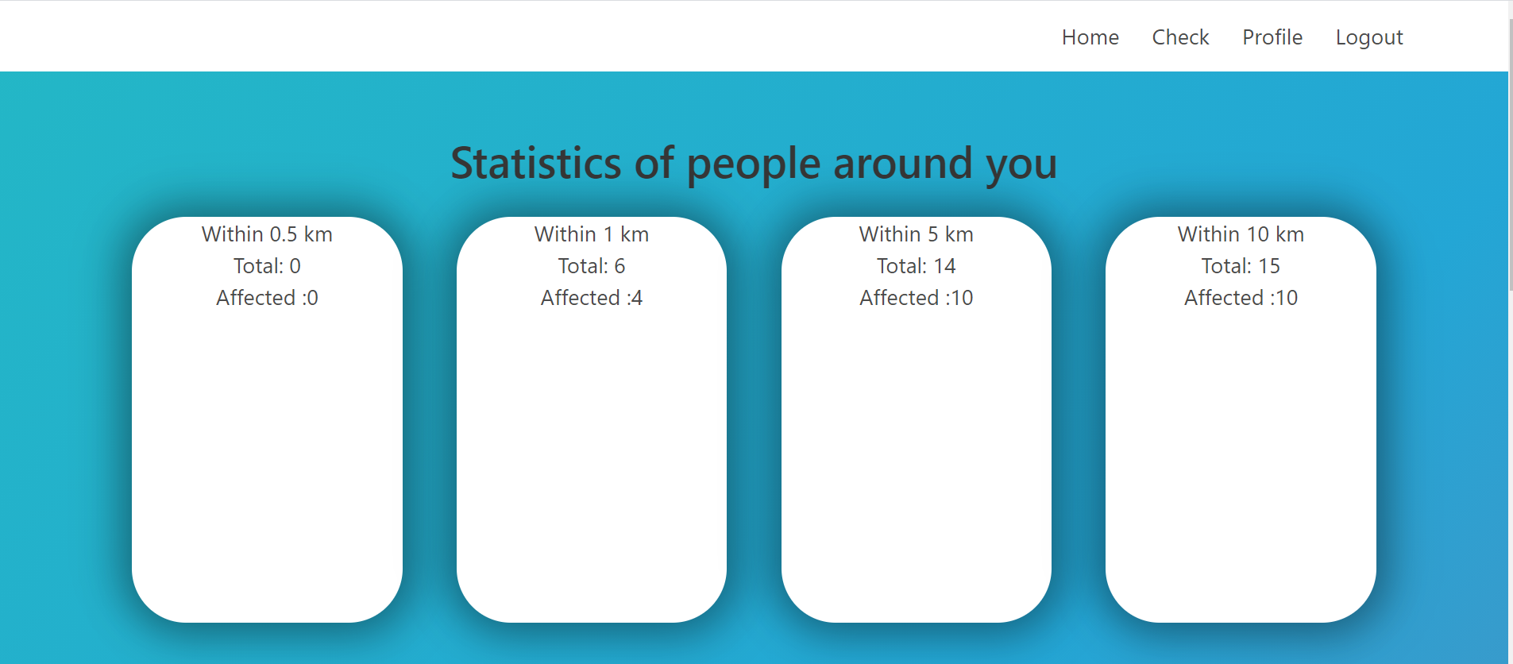
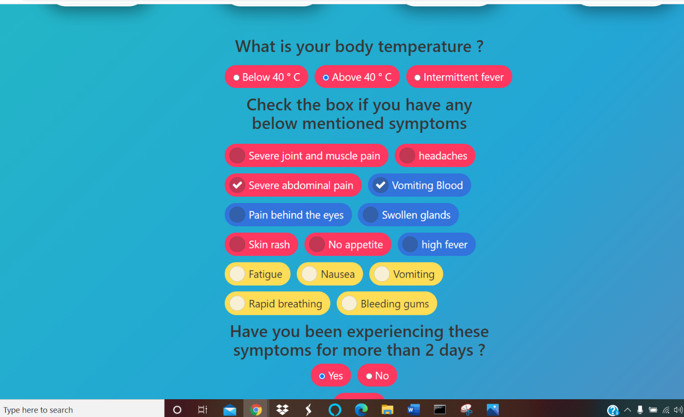

Slide 19
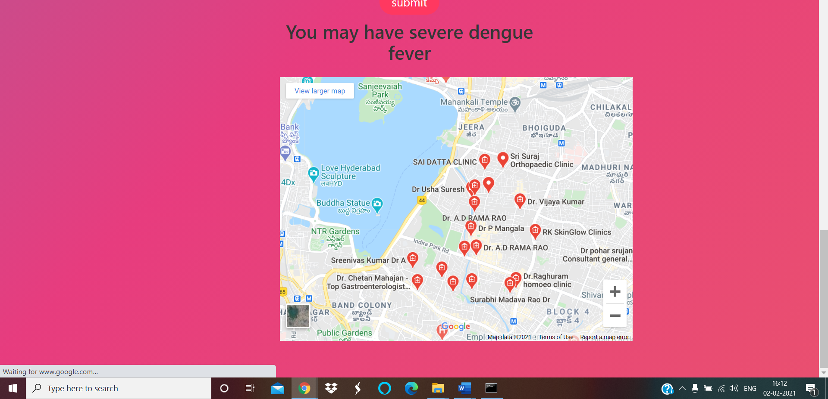

Slide 20
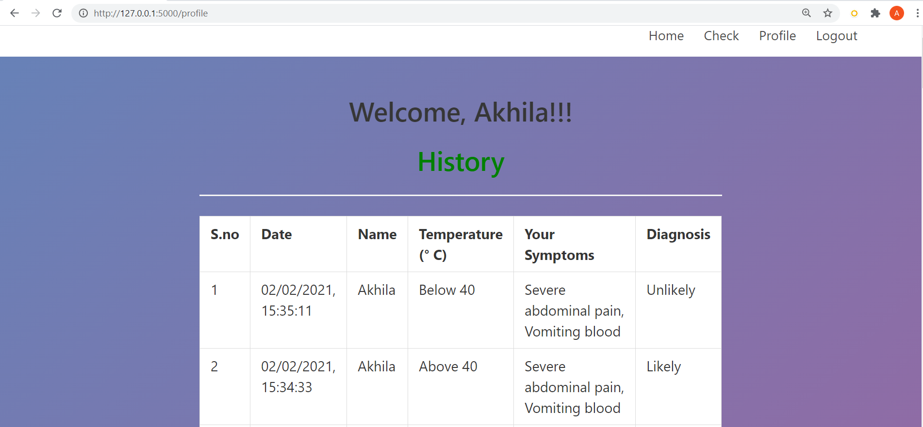

Slide 21
Conclusions and Future Scope
Conclusion:
Estimating the number of cases will be helpful for the medical community in both preparedness and treatment care.
User can check their symptoms, know about affected people nearby and take precautions
Future scope:
Hygiene factors, medicine suggestions can be considered in future work

Slide 22
Thank you

